Slide 1
Dementia
What is it?
What does it do to our lives?

Slide 2
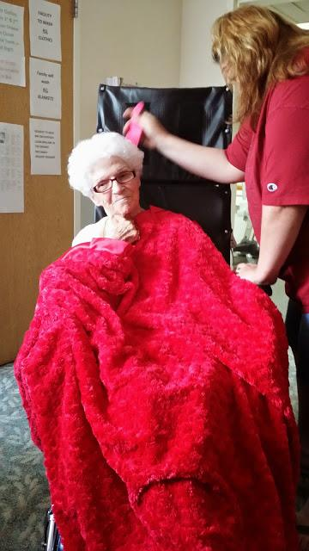
Dementia is cruel and unbiased when claiming your brain as its home.
Dementia hits home for me. My maternal Grandma passed away in 2009 after suffering form Dementia, particularly vascular disease, for quite some time. Even more recently my Grandma-n-law was diagnosed with Dementia her focus being Alzheimer’s. While doing my research for this paper Grandma passed away. Being a caregiver of someone that is losing their mind (literally) is one of the hardest things that I have had the pleasure of doing.
In this research we will learn what Dementia is and what it does to the victims and their caregivers.

Slide 3
Dementia is a “clinical syndrome” characterized by progressive deterioration in multiple cognitive domains which is severe enough to interfere with daily functioning. (McNamara).
The Alzheimer's Association says Dementia is caused by damage to the brain. The damage interferes with the brain cells ability to communicate with each other. This affects thinking, behavior, and feelings.
Different kinds of Dementia are associated with particular regions of the brain. Alzheimer’s disease, for example, has high levels of particular proteins inside and outside of the brain cells that make it hard for brain cells to stay healthy and communicate with each other.
The center of learning and memory in the brain is called the hippocampus. The brain cells in the hippocampus area are often the first to be damaged explaining why memory loss is one of the early symptoms of Alzheimer’s disease.
Brian cell damage that causes dementia is normally permanent and worsens over time but there are some problems that are caused by conditions like depression, medication side effects, and Vitamin deficiencies… that may improve with treatment.( The Alzheimer's Association)

Slide 4
“In other words, saying someone has “dementia” is similar to saying that someone has a fever.” (steckl)
Dementia can be caused by multiple medical problems or by one medical condition.
The most common forms of Dementia
Alzheimer’s disease
Vascular Disease
Lewy Body Disease
According to Carrie Steckl a lot of people mistakenly use dementia as a synonym for Alzheimer’s disease.
Dementia is an umbrella-like term that refers to any brain syndrome that causes multiple cognitive deficits.

Slide 5
Dementia is one of the leading causes of death in older people. A follow-up study of nursing home residents with advanced dementia suggested that 55 percent of the patients died over eighteen months; pneumonia, febrile episodes, and eating problems are the most frequent complications that significantly contribute to the six-month mortality.
There are several determinants of Dementia including, Gene Mutations and Genetic Risk Factors, Vascular Risk Factors, High Blood Pressure, and Diabetes Mellitus… Dementia is a major cause of functional dependence, institutionalized, and mortality among elderly people. As the population ages in the decades to come, dementia will reach an epidemic level, a scenario that poses a serious threat not only to public health but also to the social and economic development of the modern society.

Slide 6
Mayo Clinic Staff we will be looking at tests and diagnoses for Dementia. Dementia symptoms have many causes so it is sometimes hard to diagnose and may take several visits to do so. To diagnose your condition, your doctor will review your medical history and symptoms and conduct a physical examination.
Doctors may order a number of tests to diagnose dementia and rule out other conditions.
Cognitive
Neuropsychological tests
Neurological evaluation
Brain scans
Laboratory tests
Psychiatric evaluation
Cognitive and neuropsychological tests evaluate your thinking. A number of tests measure thinking skills such as memory, orientation, reasoning and judgment, language skills, and attention. In a neurological evaluation, doctors will evaluate your movement, senses, balance, reflexes and other areas.

Slide 7
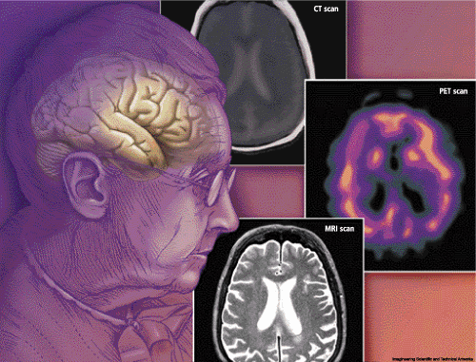
Brain scans, such as a CT or MRI, are used to check for evidence of stroke or bleeding and to rule out a tumor.
In laboratory tests they do simple blood tests to rule out physical problems that can affect brain function, such as vitamin B-12 deficiency or an underactive thyroid gland. A psychiatric evaluation may be done by a psychologist or a psychiatrist. They will evaluate whether or not other conditions, such as depression or another psychological condition, may be causing the symptoms.

Slide 8
Models of dementia, including the disease model or the disability model, should be left behind, because they limit therapeutic possibilities for people with dementia, says Julie Watson.
the challenge is to think ethically about how to avoid burdening people who have dementia with invasive medical treatments that prolong suffering.
the challenge is to reduce the stigma associated with dementia, by being with those who have dementia and caring in ways that draw upon their remaining emotional, relational, spiritual and aesthetic capacities.
A first step towards establishing realistic goals is recognizing the progressive and terminal nature of dementia in order that systems. The Gold Standards Framework (GSF) is a systematic, evidence-based approach that optimizes the care of people nearing the end of life, whether their prognosis is months, weeks or days.

Slide 9
There are common physical and cognitive indicators exist that suggest those diagnosed with dementia are in the last 6 months of life.
Language/speech loss
Inability to walk without assistance
The need for help with all activities of living
Incontinence
Poor food intake
Recent weight loss

Slide 10
Because dementia occurs most often in old age, it is important to understand several brain changes that occur with aging, and which of these result from normal physiological brain aging and which from dementing illnesses.
Brain shrinkage is one of these changes.
Brain shrinkage starting at 50years old is normal.
Weighing about 1.3kg and ending at about 1.2kg by the age of 65.
However it is not because a generalized loss of nerve cells, as much as it is water loss. As the brain shrinks with age, the gaps between folds of the cortex (sulci) widen and the spaces (ventricles) inside the brain enlarge. In Alzheimer’s disease, this cortical shrinkage is more extensive and may be more marked in specific local regions such as the temporal or parietal areas. Magnetic resonance imaging (MRI) reveals the distribution of water in brain tissue and can thus be used to detect brain shrinkage.

Slide 11
“The focus of dementia research in the 1980s was very much about the experiences of caregivers of people with dementia.” (Innes)
For example, the gender differences and coping, stress and burden experienced, and access to information and services. Although, the popularity of research looking into family caregiving, there is still very little consensus about what works and does not work for family caregivers, much research on family caregivers focused on stress and strain n experienced in dementia caregiving. The reasons for the stress and strain labeled as “caregiver burden” have been well documented. These include lack of support for caregivers, lack of financial resources, further stress on already strained relationships, and poor physical health on part of the caregiver. These have been summarized as resources available to caregivers, care-related stressors and contextual variables. While it is clear that the positive aspects of caregiving are beginning to receive more attention and have been identified as an area worthy of, the issue of the quality of care that family caregivers provide has been largely unexplored.

Slide 12
Caregivers face many obstacles as they balance caregiving with other demands, including child rearing, career, and relationships. They are at increased risk for burden, stress, depression, and a variety of other health complications. The effects on caregivers are varied and difficult, and there are many other factors that may impair or improve how caregivers react and feel as a result of their role. Numerous studies report that caring for a person with dementia is more stressful than caring for a person with a physical disability. (Brodaty, MD)

Slide 13
In this paper we have discussed what Dementia is and how it affects our lives.
Dementia is an umbrella-like term that refers to any brain syndrome that causes multiple cognitive deficits.
Alzheimer’s being the most common form of Dementia. Dementia is caused by damage to the brain.
The damage interferes with the brain cells ability to communicate with each other.
Tests like MRI’s and Cat Scans along with psychiatric evaluations may be done to help determine if Dementia is the right diagnoses.
Dementia is one of the leading causes of death in older people. Care givers often have a higher stress rate.
The reasons for the stress and strain labeled as “caregiver burden” include lack of support for caregivers, lack of financial resources, further stress on already strained relationships, and poor physical health on part of the caregiver.
Dementia not only affects the person suffering from the disease, but also the family members, who are often the care takers, as well.

Slide 14
Works Cited
Brodaty, Henry, and Marika Donkin. "Abstract." National Center for Biotechnology Information. U.S. National Library of Medicine, 28 Nov. 0005. Web. 06 Nov. 2014.
Dementia-Patients. By Dinesh Chandra Gaur. Fig. 3
"Dementia." Tests and Diagnosis. N.p., n.d. Web. 23 Oct. 2014. <http://www.mayoclinic.org/diseases-conditions/dementia/basics/tests-diagnosis/con-20034399>.
Grandma & I, Springfield Ohio. Personal photograph by author. 2014. Fig. 1
Innes, Anthea. Dementia Studies : A Social Science Perspective. Los Angeles: SAGE, 2009. eBook Collection (EBSCOhost). Web. 24 Oct. 2014.

Slide 15
Works Cited
McNamara, Patrick. Dementia [Electronic Resource] / Patrick Mcnamara, Editor. n.p.: Santa Barbara, Calif. : Praeger, c2011, 2011.Sinclair Library. Web. 19 Oct. 2014.
Steckl, Carrie, Ph.D. "Alzheimer's Disease and Other Cognitive Disorders, Dementia." Golf Bend Center. N.p., n.d. Web.
Watson, Julie. "What Is Dementia? Implications For Caring At The End Of Life." End Of Life Journal 3.1 (2012): 1-9. CINAHL Complete. Web. 17 Oct. 2014.
Whalley, Lawrence J., and John CS Breitner. Dementia. Abingdon: HEALTH Press, 2009. eBook Collection (EBSCOhost). Web. 24 Oct. 2014.
"What Is Dementia?" Dementia – Signs, Symptoms, Causes, Tests, Treatment, Care. N.p., n.d. Web. 17 Oct. 2014. <http://www.alz.org/what-is-dementia.asp>.

